Slide 1

Sponsor Presentation
Booz Allen Hamilton Data Driven Human Performance Project
11/20/20

Slide 2
Agenda
1 | Welcome & Team Introductions
2 | Project Overview
3 | Current State
4 | Pain Points/Metrics for Success
5 | Proposed State
6 | Immediate Next Steps
7 | Vision For the Future

Slide 3
Welcome and Introductions

Slide 4
Introductions from Notre Dame
Name | Company | Role
Joey Babyar | Rizing HCM | Project Manager
Angela Stitsworth | Beacon Health System | Digital Design & Customer Experience Analyst
Jaime Sanchez Alba | University of Notre Dame | Strategic Initiatives Analyst
Brian Rycyna | E78 Partners | Senior Associate
Claire Kozak | GATX | Chemical Engineer
Zachary Boiskin | Protiviti Inc. | Data & Analytics Consultant

Slide 5
Introductions from Booz Allen Hamilton
Name | MSBA Role | Professional Role
Kevin Vigilante | Executive Sponsor | Chief Medical Officer and Executive Vice President
Cutter Brenton | Analytics Lead | Principal
JC Sullivan | Primary POC Analytics – Data Science | Associate
Matt Habrowski | Analytics – Data Science | Associate
Colin Friedman | Analytics – Data Science | Associate
Dom Angelotti | Analytics – Data Science | Senior Consultant
Laurel McKenzie | Human Performance SME | “Client”
MR Blank | Human Performance SME | “Client”

Slide 6
Project Overview

Slide 7
Project Charter
Data Driven Human Performance Project
Problem Statement
Business Case
Booz Allen Hamilton has been tasked by a DoD client to pilot its Tactical Athlete Paradigm (TAP), centered on the collection and analysis of human performance data. However, due to time and security constraints, field experts have had to rely on readily available tools.
Existing process has many fragmented elements
Current tools require manual data entry and audit
Field experts do not have readily available access to analytics to demonstrate immediate value add
Booz Allen Hamilton hopes to demonstrate the value proposition of its TAP program by:
Creating operational efficiencies and analytic value add in the short term
Building incremental progress toward a clear vision for longer term goals in a mission-oriented organization.
Goal Statement
Scope and Risks
Construct a data ingestion framework to pipeline human performance data into an analytic environment
Leverage data gathered throughout the pilot effort to design case driven, modularized human performance analytics
Provide strategic assessments and recommendations for the future direction of the pilot program
In Scope:
Use of live data gathered during the pilot program
Access to current tools and processes implemented to run pilot program
Out of Scope and risks:
No access to APIs from currently used platforms
Security walls prevent streamlining of current process
Time constraints limit MSBA’s ability to further refine initial minimum viable product

Slide 8



Specific Tasks
Construct a data ingestion framework
Pipeline raw flows of human performance data from a variety of sources into an analytic environment.*1​
2. Design modularized human performance analytics
Utilize open-source human performance data to design use case driven, modularized human performance analytics to be deployed on collected data.*2
3. Present a final report
That both summarizes your data ingestion and analytics methodologies and provides strategic recommendations for the continued execution of the pilot program.
*1 Excel data schema
*2 Swell dataset

Slide 9
Current State

Slide 10
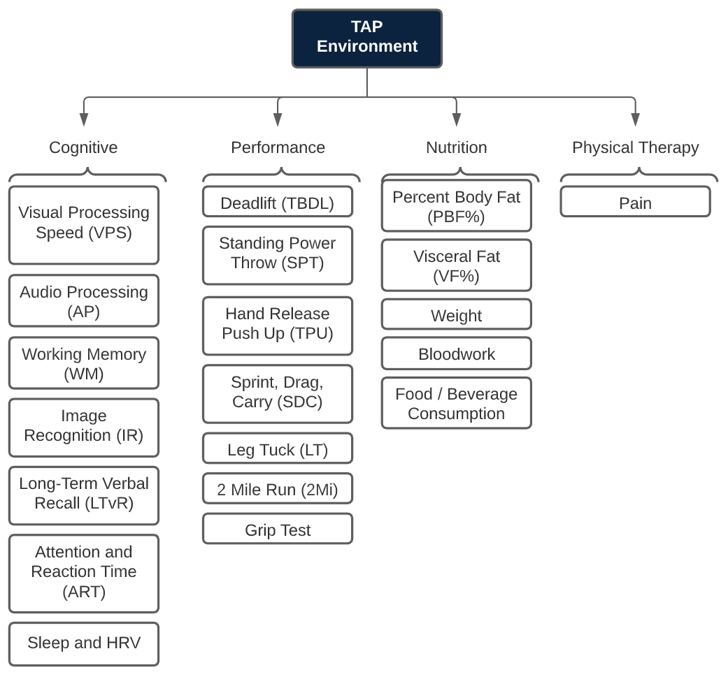
TAP Environment

Slide 11





Current State Process Map
Participant fills out paper form
Coach manually enters data
Coach manually calculates RAG scores
Faxes form to coach
No analytics are performed
Start

Slide 12
Pain Points/Metrics For Success

Slide 13
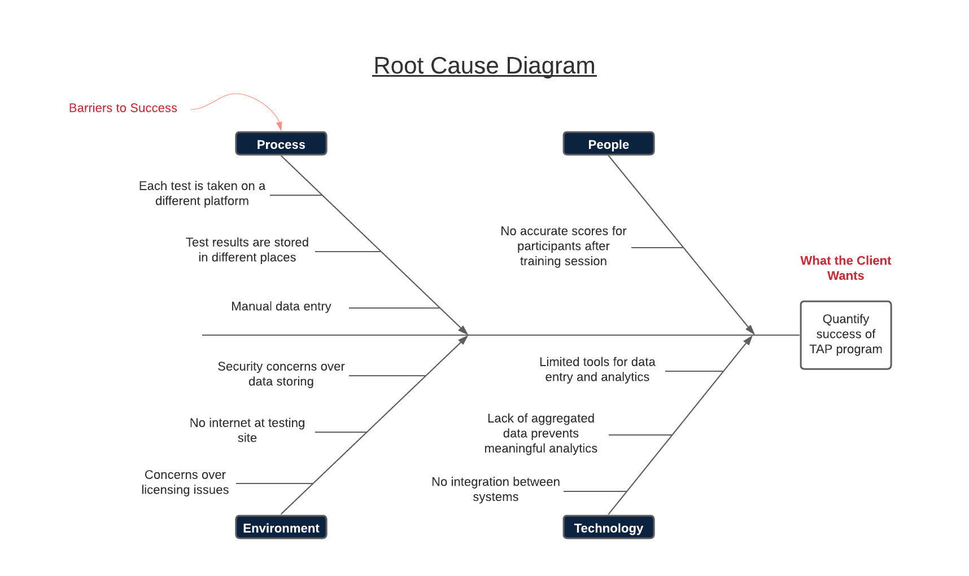
Pain Points

Slide 14
Metrics for Success
What will a successful project look like?
Get manual processes into some degree of automation
“One stop shop” for data entry
Determine performance benchmarks
How will we know we’re there?
Fully functioning end-to-end solution that summarizes and provides key metrics gathered from pilot program
Correlation findings for human performance data

Slide 15
Proposed State

Slide 16



Proposed State Process Map
Participant fills out paper form
Coach manually enters data
Coach manually calculates RAG scores
Faxes form to coach
No analytics are performed
Start
Participant fills out online Qualtrics survey
Data and RAG scores automatically populate Power BI for analytics

Slide 17
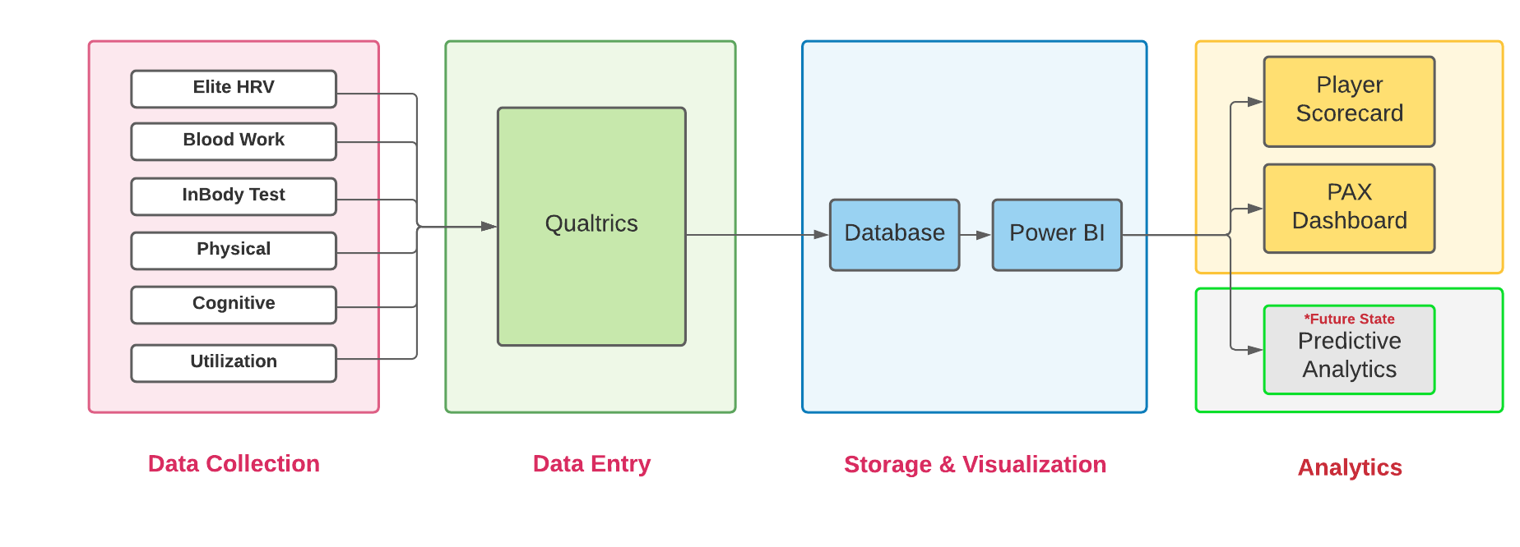
Proposed State Process Map

Slide 18
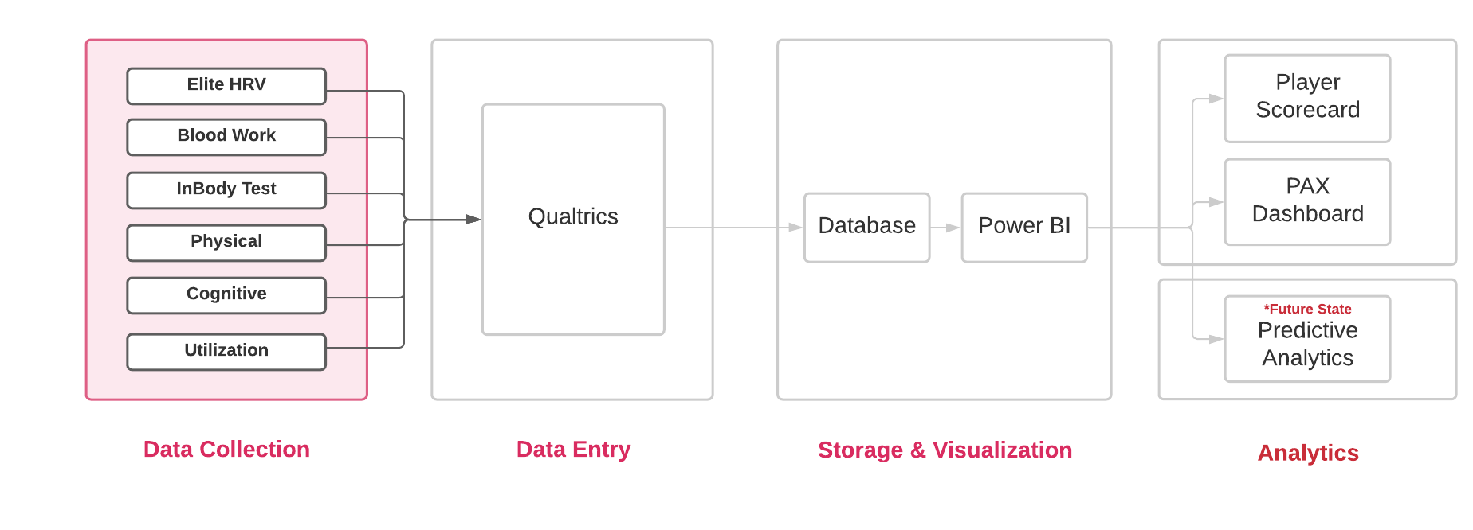
Proposed State Process Map

Slide 19
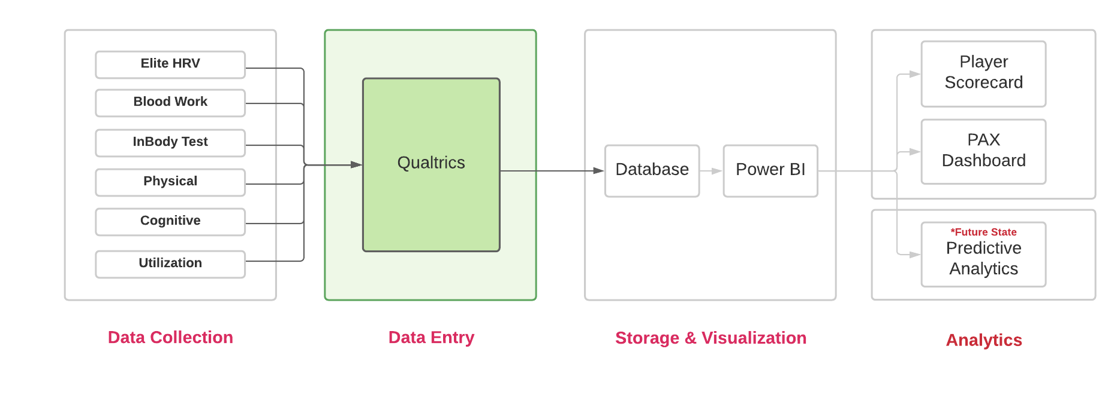
Proposed State Process Map

Slide 20
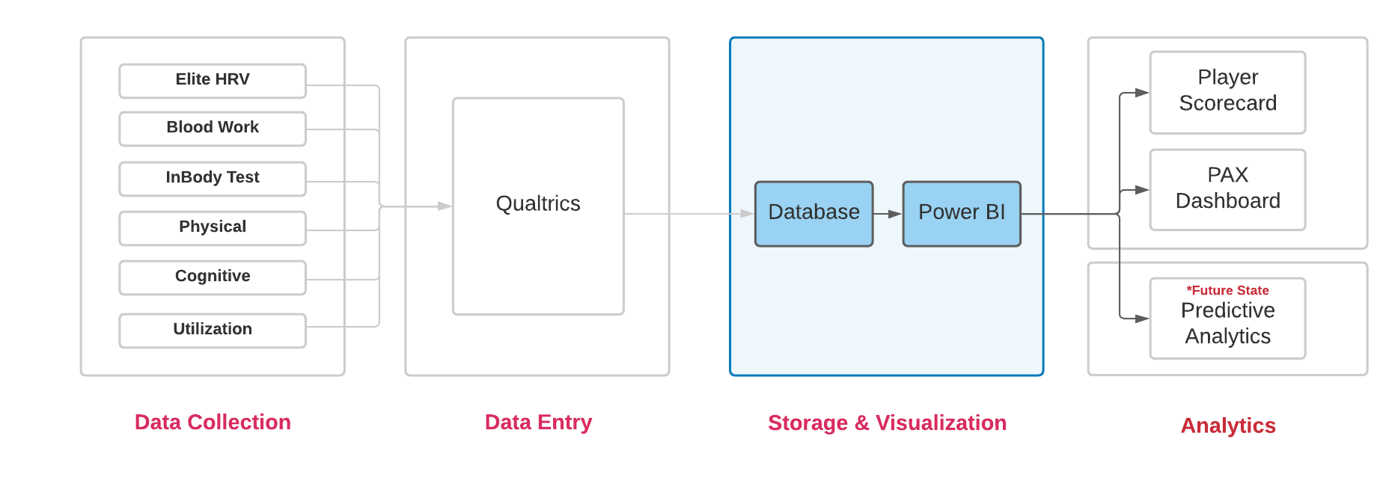
Proposed State Process Map

Slide 21
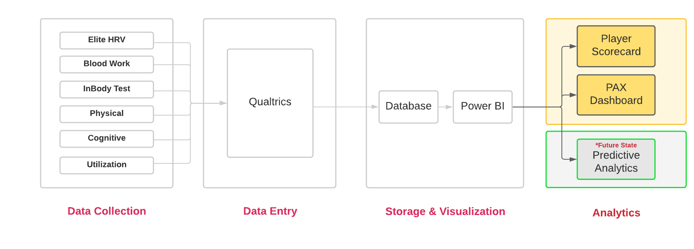
Proposed State Process Map

Slide 22
Proposed State Process Map

Slide 23

Solution #1: Develop a Solution for Raw Data Consumption
Qualtrics
Database
Power BI
PAX Dashboard
Scorecard
Analytics
Participant Receives Link to Complete Survey via E-Mail
Survey Completed Online
Once Complete, DoD Team Receives Auto-Responses
PAX Survey

Slide 24
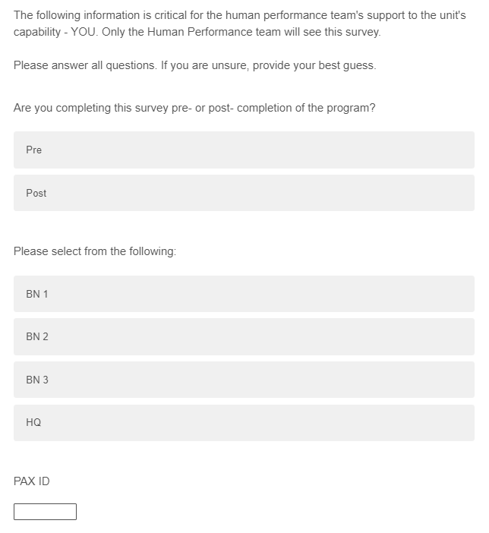
Solution #1: Develop a Solution for Raw Data Consumption
Qualtrics
Database
Power BI
PAX Dashboard
Scorecard
Analytics
PAX Survey

Slide 25

Solution #1: Develop a Solution for Raw Data Consumption
Coach Enters PAX ID and Group #
Blood Work
InBody Test
Physical
Cognitive
Table Of Contents
(choose which survey block to complete)
Elite HRV
Utilization
Qualtrics
Database
Power BI
PAX Dashboard
Scorecard
Analytics
Coaches Survey
1) End Survey and Submit Responses
2) Return to Table of Contents to Complete Another Survey Block

Slide 26
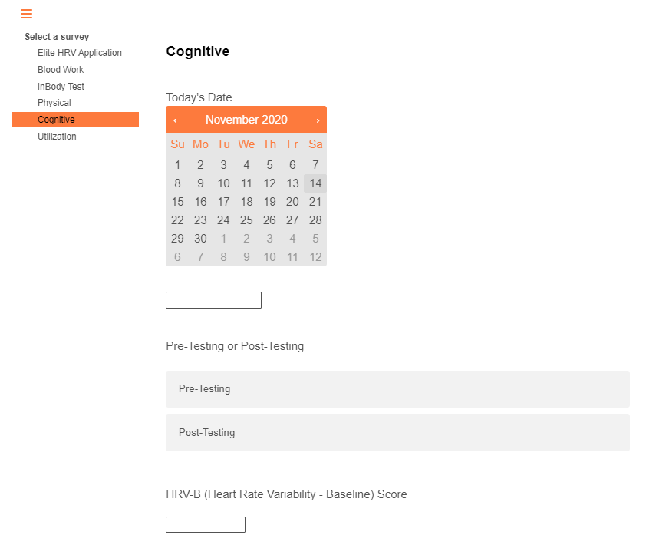
Solution #1: Develop a Solution for Raw Data Consumption
Qualtrics
Database
Power BI
PAX Dashboard
Scorecard
Analytics
Coaches Survey

Slide 27
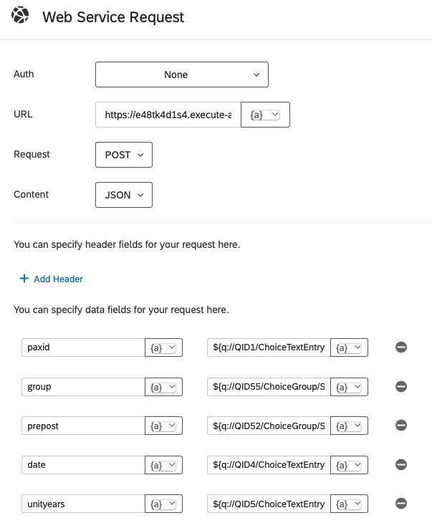
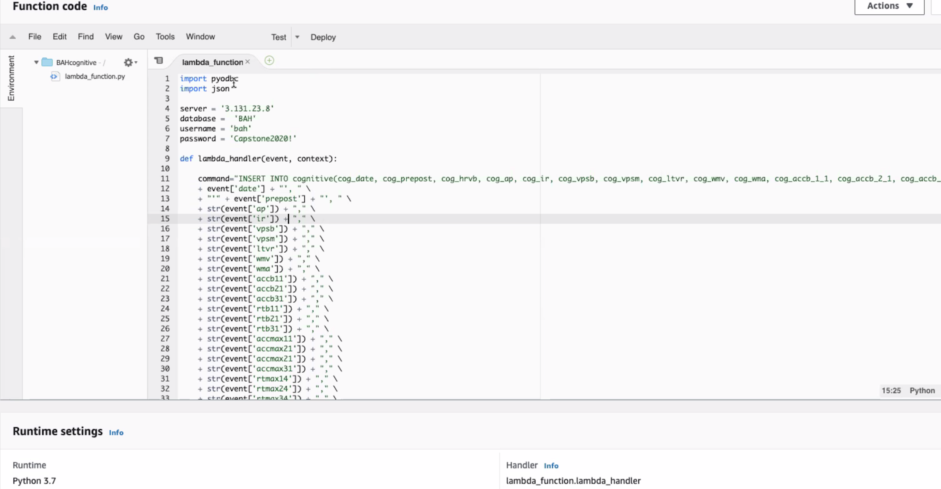
Solution #2: Develop a Solution to Ingest Data
Qualtrics
Database
Power BI
PAX Dashboard
Scorecard
Analytics

Slide 28
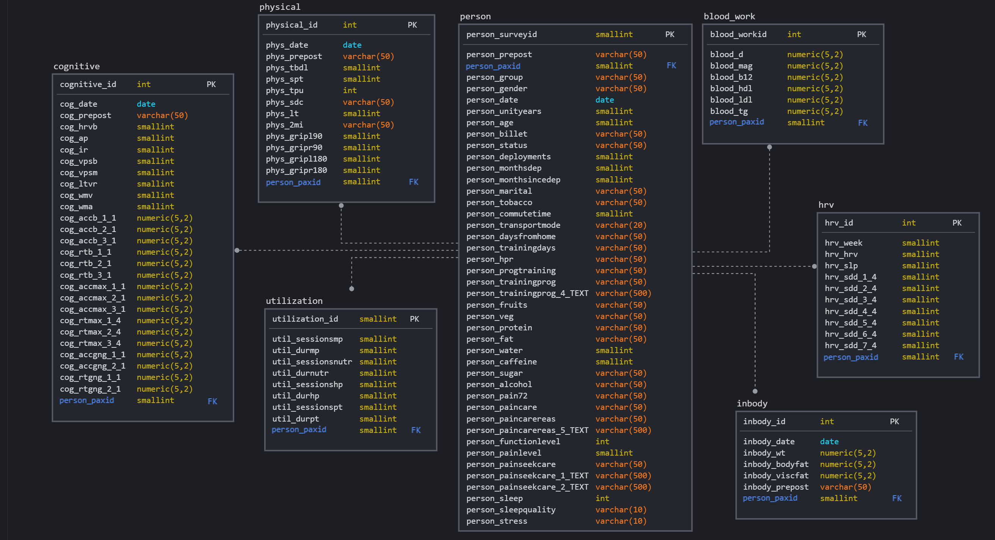
Solution #3: Create a Single Data Repository (Database)
Qualtrics
Database
Power BI
PAX Dashboard
Scorecard
Analytics

Slide 29
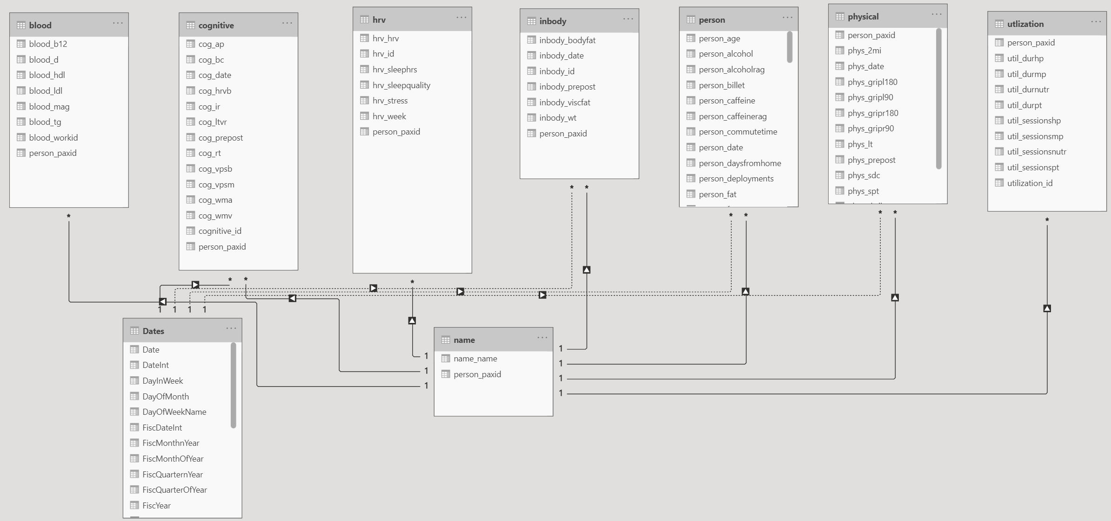
Solution #4: Leverage Powerful, Flexible Business Intelligence Tools for Data Visualization
Qualtrics
Database
Power BI
PAX Dashboard
Scorecard
Analytics

Slide 30
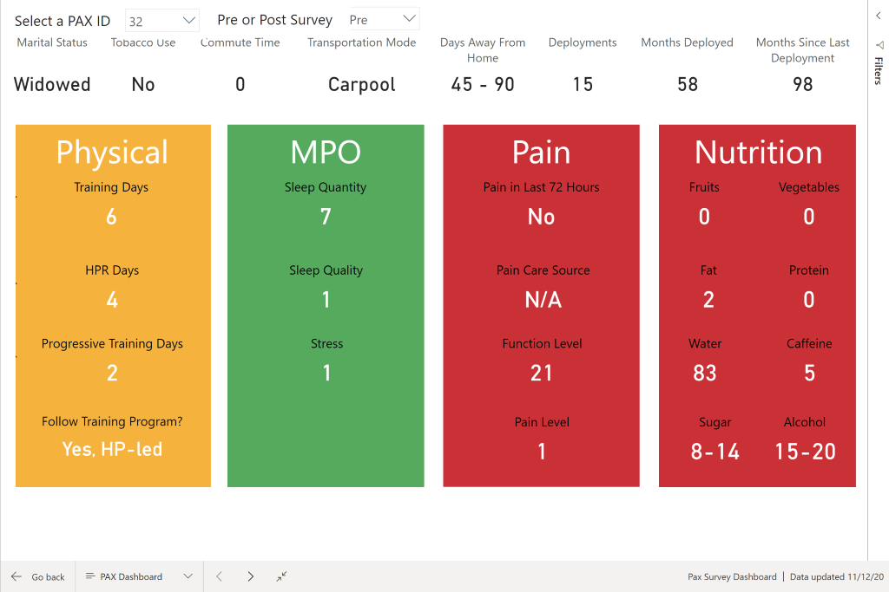
PAX Dashboard
Qualtrics
Database
Power BI
PAX Dashboard
Scorecard
Analytics

Slide 31
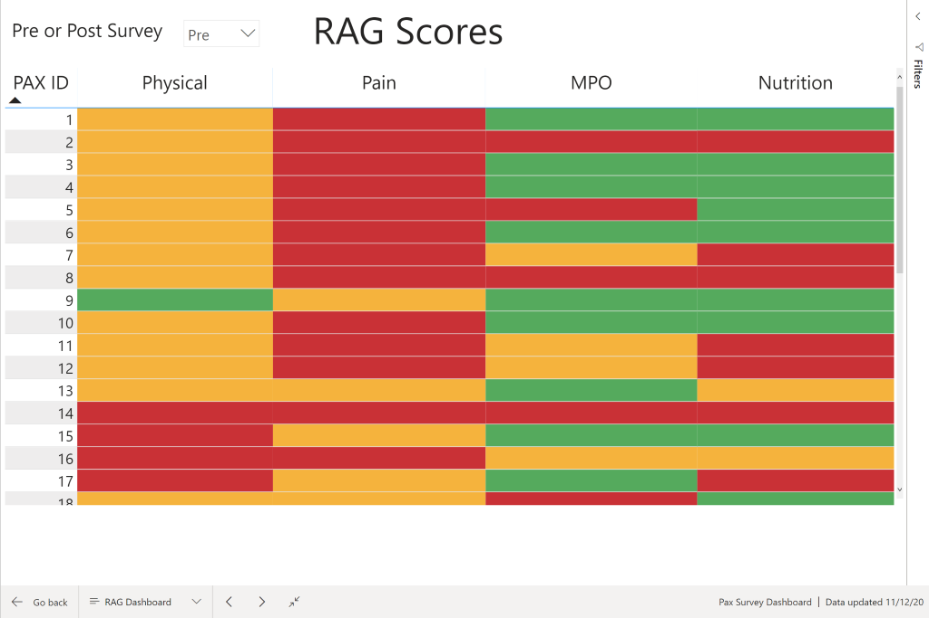
PAX Dashboard
Qualtrics
Database
Power BI
PAX Dashboard
Scorecard
Analytics

Slide 32
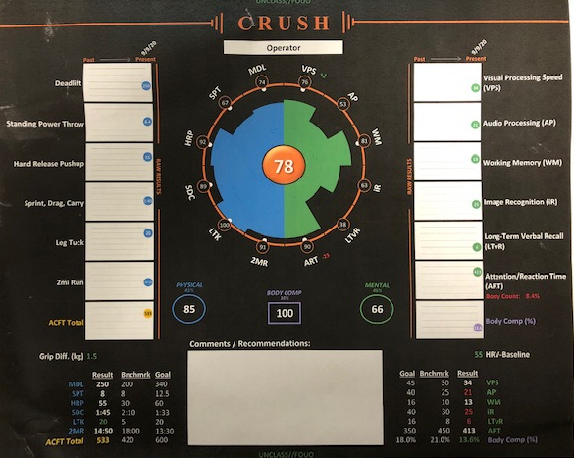
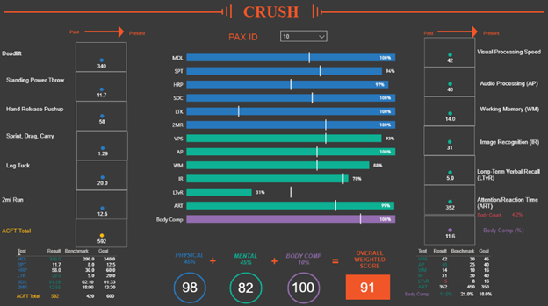
Solution #5: Utilize Sound Statistical Methods for Meaningful, Actionable Insights
Qualtrics
Database
Power BI
PAX Dashboard
Scorecard
Analytics
Past
Present

Slide 33
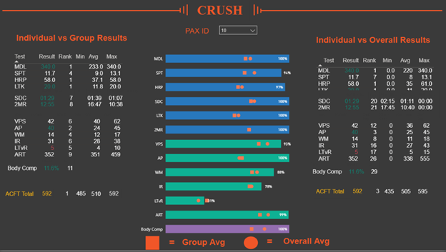
Individual vs Group Scorecard
Qualtrics
Database
Power BI
PAX Dashboard
Scorecard
Analytics
Compare Performance vs Group and Overall:
Ranking
Benchmarks:
Min
Avg
Max

Slide 34
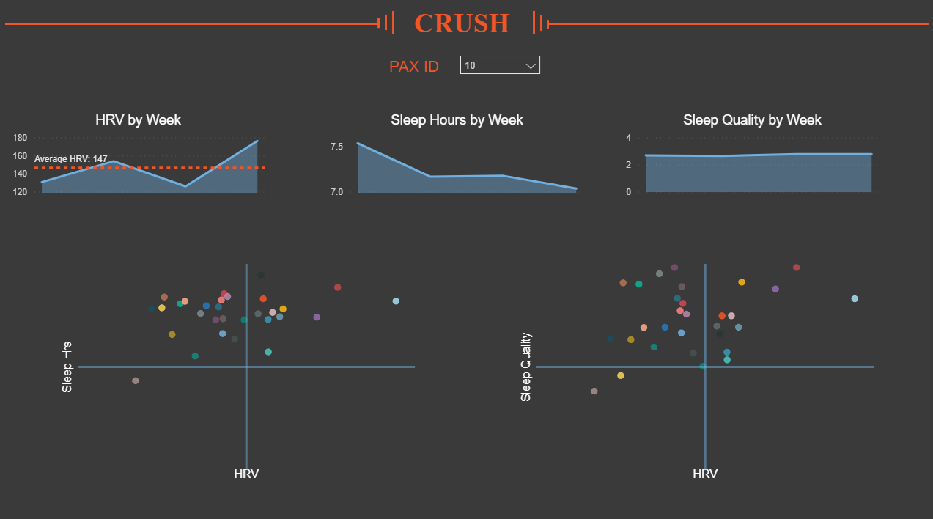
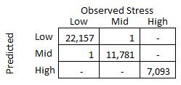
Predictive Analytics
Qualtrics
Database
Power BI
PAX Dashboard
Scorecard
Analytics
TAP Data
MSBA Team will perform statistical analysis upon conclusion of the initial program during the first week of December
Goal is to report and Pre/Post performance analytics in final presentation
SWELL Data
Removed highly correlated features and reduced measured HRV variables from 35 to 13
Created a Random Forest model to use HRV data to predict between low, mid and high stress levels.
Use after linking wearable device data in database to match relevant variables
Only incorrectly predicted 2 observations out of 41033 in test set

Slide 35
Immediate Next Steps

Slide 36
Immediate Next Steps
Re-structure PAX IDs to be unique identifiers
Re-structure survey questions for better data management
Transition away from intermediate spreadsheets
Use a matrix format to support multiple entries

Slide 37
Vision for the Future

Slide 38
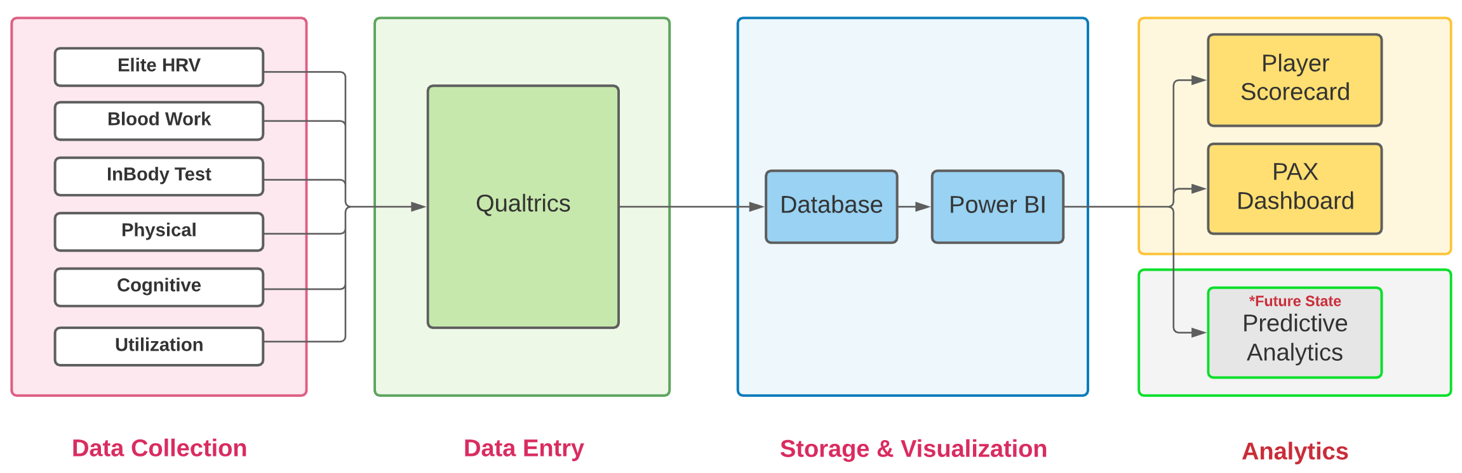





Recommendation #1: Create a Single Integrated Environment for Human Performance Data

Slide 39
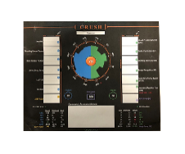



Recommendation #2: Redesign the Delivery and Processing of Cognitive Tests
Participant completes tests
Coach calculates scores
Coach audits/edits responses
Coach manually enters data
Scorecard printed
Start
Psych Lab 101
?
New integrated solution
Data and RAG scores automatically populate Power BI for analytics

Slide 40
Recommendation #3: Leverage Human Performance Data for Advanced Analytics
Capstone engagement and TAP program started in parallel
Leverage the entire human performance data environment

Slide 41



TAP Roadmap
Past State
Current State
Next Steps
Develop core metrics
Implement a functional process to start participant testing ASAP
Develop an initial scorecard to assess participant’s performance
Centralized data collection
Developed data repository
Improved participant scorecard
Performed initial group level analytics
Integrate all apps into one database
Redesign the delivery and processing of cognitive tests
Leverage human performance data for advanced analytics

Slide 42
Thank you
Booz Allen Hamilton!

Slide 43
Appendix

Slide 44
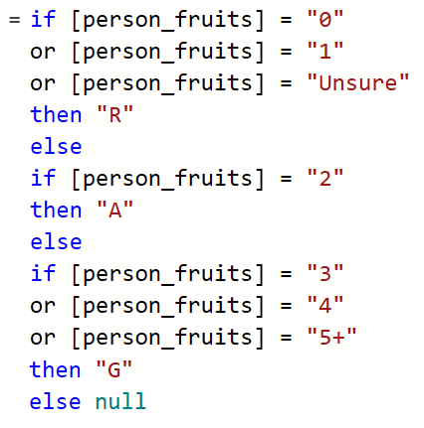
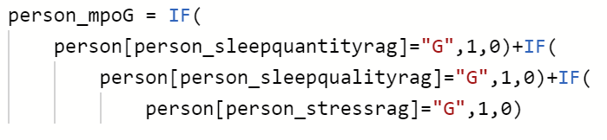
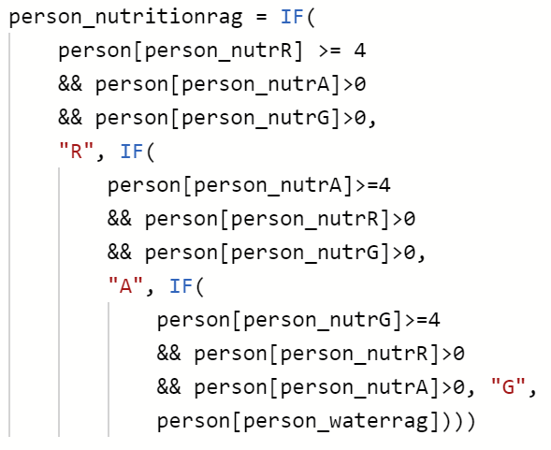
PAX Dashboard
Multi-Step Process to calculate RAG Scores
1 | Power Query Logic to Calculate Individual RAG Scores
2 | DAX Logic to sum scores in category
3 | DAX logic to calculate score based on majority rule

Slide 45



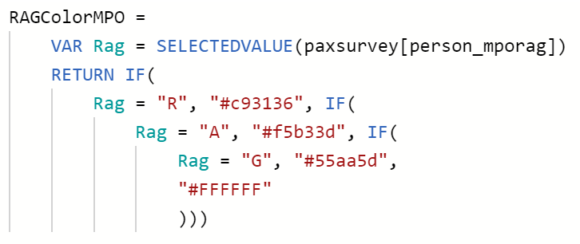
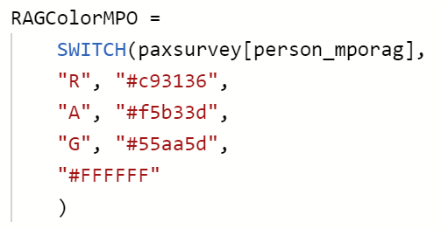
PAX Dashboard
1. Change individual card visualizations to tables
4.6 s
1.6 s
2. Change logic statements from IF to SWITCH
3. Change measures to calculated columns

Slide 46
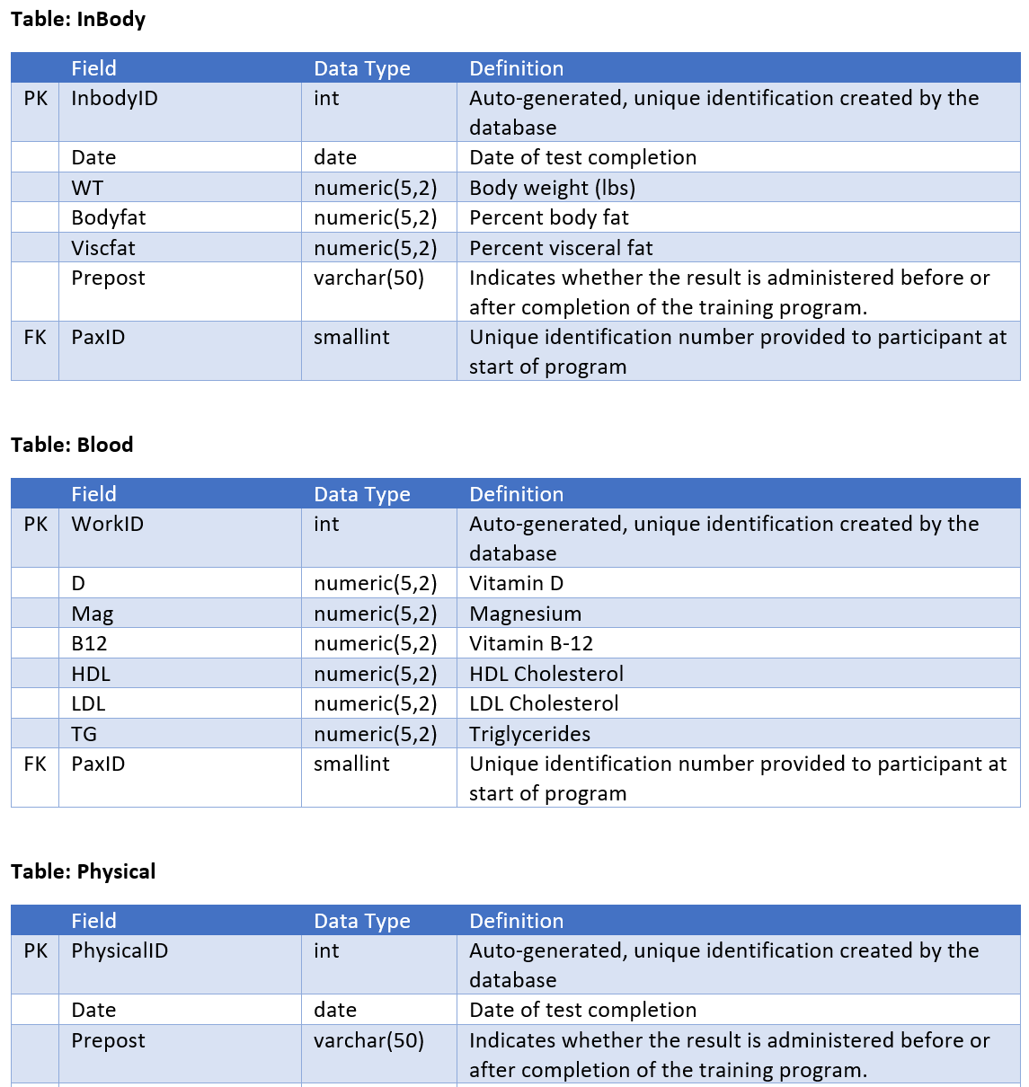
Data Dictionary

Slide 47
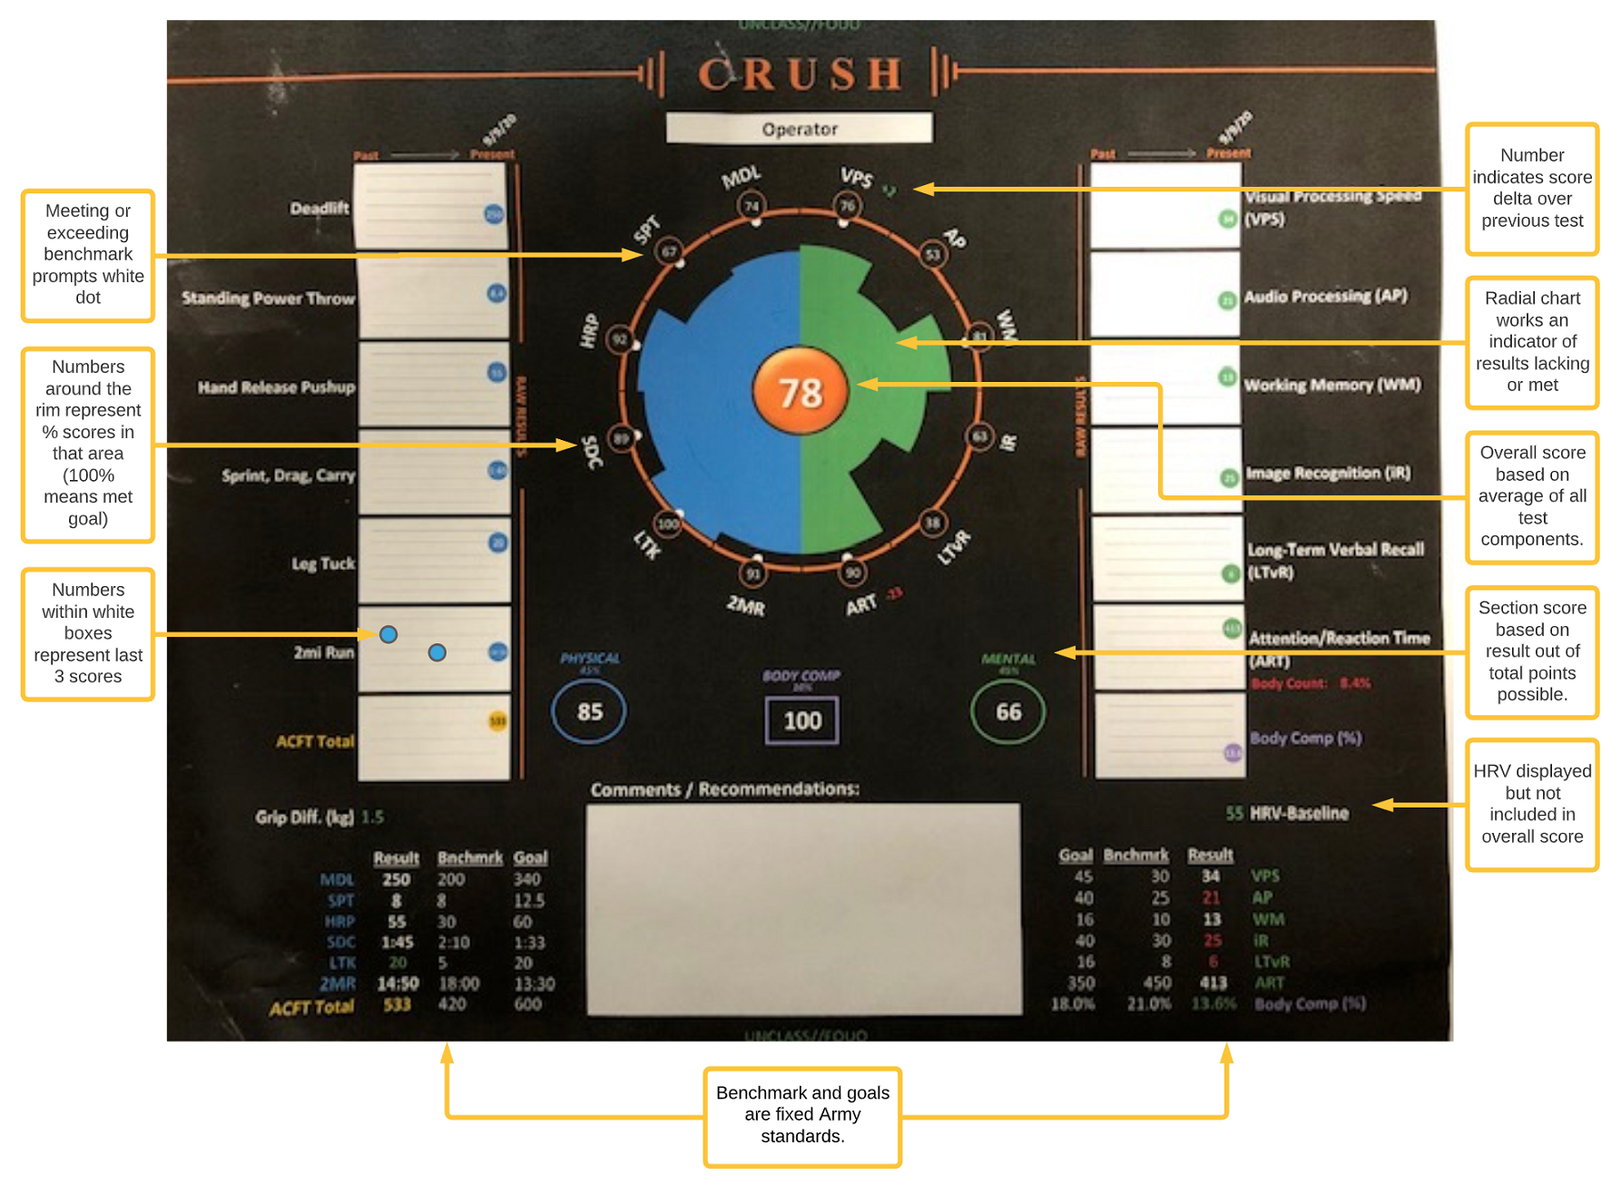
Scorecard Elements

Slide 48
